Slide 1
Robot Project Meeting – 11/10/2018
Bourgogne, Colrat, Evaux, Gaizi, Nicolle – ACE TEAM

Slide 2
Last Meeting:
The following are the points we discussed:
Using the project management tool in Excel
Doing the CNN on a raspberry pi for now
To be done:
@All student: make block diagrams clearer by showing the link between sub-blocs, identifying the blocs within the AURIX
@Abdoul: Forward the excel project management tool already sent to Amine

Slide 3
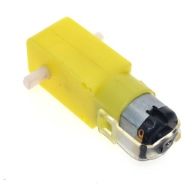
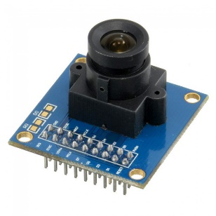
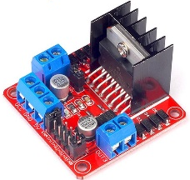
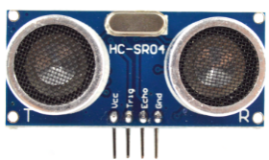
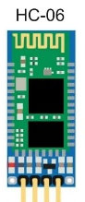

Block Diagrams: Robot Project
Motors
Camera
Aurix Master
TC297B-Step
Aurix Cam
TC297B-Step
Ultrasonic
Uart
Uart
Ethernet
Bluetooth
Raspberry Pi 3B+
Bluetooth
PC command
Uart
Uart

Slide 4
Block Diagrams: Aurix TC297-B number 1
Movement
Equipment: 2 Motors, 2 Encoders, H Bridge
Aurix Modules: GPO, GTM TOM, ERU
Control the robot‘s movements in all 4 direction with variable speed
Bluetooth
Equipment: Module Bluetooth HC-05
Aurix Modules: ASC(LIN)
Adds wireless communication capabilities to the robot through Bluetooth
Ultrasonic detection
Equipment: ultrasonic sensor HC-SR04
Aurix Modules:ERU, GPIO, STM
Detects the presence of obstacle, and measure distance to the nearest one
Camera
Equipment: camera OV7670, Raspberry Pi 3B+, 2x HC-06
Aurix Interfaces: CIF, Ethernet
Detect Numbers (from 1 to 5)

Slide 5
Subtasks: Amine Wheel enslavment
Done:
Trying to code Acceleration and Deceleration functions to minimize the robot‘s inertia
Corrected a bug with PWM signal
To Do:
Look at the Management Tools sent by Abdoul
Find porportionate coefficient between the two motors to start implementing P correction
Work on Integrate correction
Deadline: Mid November

Slide 6
Amine: Movements Block Diagrams
*H-Bridge Pin Assignment for going forward, to go backward invert In1 with In2 and In3 with In4
Aurix TC297-B Step
Encoder Output
External Request Unit
Encoder Output
Port 15 pin 5
Port 10 pin 7
Mesures distance and stops
PWM signal
GTM Timer Output Module
PWM signal
Port 33 pin 6
Port 00 pin 12
General Purpose Outputs
Triggers
H-Bridge*
EnB
In4
In2
EnA
P33.4
P33.2
P00.4
P00.6
In1
In3
Motor
Out B
Out A
Motor
Supplies Robot Motors in current

Slide 7
Subtasks: Marlon
Done: None
To do: None

Slide 8

Marlon: Ultrasonic Sensor Block Diagrams
TC29TF
Ultrasonic Sensor
HC-SR04
8 impulses
CPU ctrl
P14.4
High signal for >= 10 µs
sendTrig()
Trig
G
P
I
O
P14.4
returnDistance()
External interrupt input
Obstacle
Echo
echo
P20.9
isrGetDistance()
ACRONYM:
ERU: External Request Unit
GPIO: General Purpose Input Output
FUNCTION OVERVIEW:
sendTrig() : send trigger to ultrasonic sensor to start obstacle detection
returnDistance(): check distance value for abnormal value and return it
isrGetDistance(): interrupt routine to get distance from Echo signal
ERU
P20.9

Slide 9
Subtasks: Virgile, Bluetooth communication
Done:
Write the Bluetooth module related section of the wiki
Code for the Bluetooth module used in polling mode
To do:
Finish the code for the Bluetooth module used in interrupt mode
Implement the Bluetooth capabilities in the final code

Slide 10
Virgile: Bluetooth communication
TC29TF
Bluetooth module
HC-05
Application
ASCLIN
rx
rx
serial_send()
P15.3
serialRxISR()
tx
tx
P15.2
commands
Responses & updates
(if requested)
Bluetooth capable device
serial_send(uint8 message):sends responses to command messages (if requested)
serialRxISR(): receives command message in interrupt mode.

Slide 11
Substaks: Maxime, Camera
Done
Run a CNN on the Raspberry Pi 3B+ (Detect & Indentify objects)
To Do
Send video to a GUI (first step) and after to the Raspberry by ethernet (I asked Rahul to help me)
Take minimum 2500 pictures to pre-train our own CNN
Bluetooth communication (Rasberry <-> Aurix Master)
Documentation on Wiki page (in progress)
Deadline: Mid of November

Slide 12
Maxime : Block Diagrams
Camera OV7670
CIF
interface
Aurix TC297-Bstep
Eth
Rasberry Pi 3B+
Aurix TC297-Bstep
(master)
Bluetooth
Established if :
Number is detected

Slide 13
Recap: Guillaume, coding on Aurix
Done:
ERU
To do:
Will work on the gyroscope. Due date: unknown, because still havn‘t look about that
Will give info on acceleration, orientation

